Slide 1




2023-08-07
Connection through SSH
(VS Code or MobaXterm)
Security barrier

Slide 2

1. VPN (local IP)
Location A
Location B
2. Connection through SSH
1. VPN (local IP)
Location A
Location B
2. Connection through SSH
(VS Code or MobaXterm)
3. Connection through SSH

Slide 3
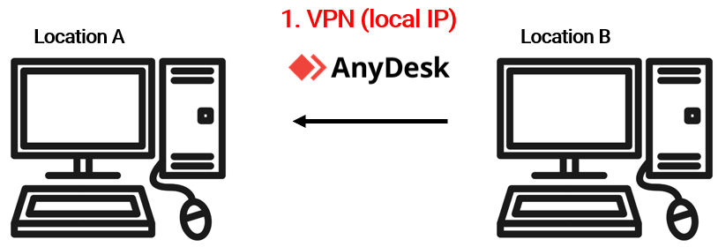
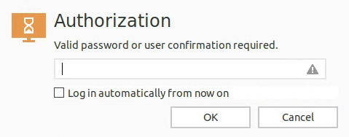
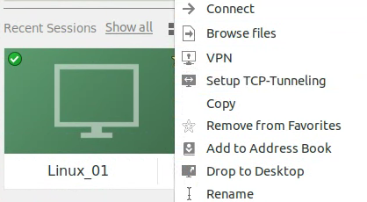
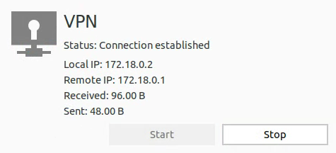
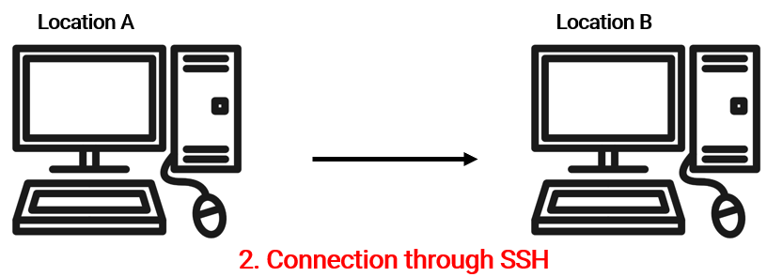

Slide 5
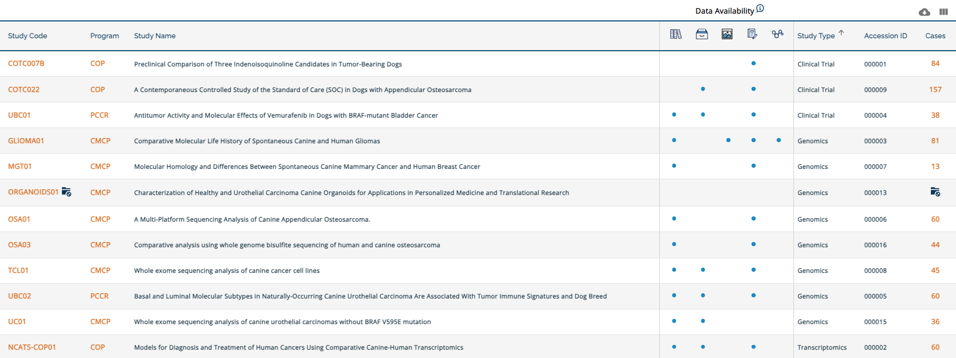
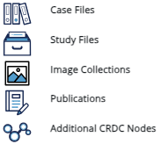
2023-09-18

Slide 6

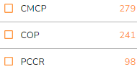
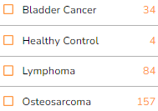
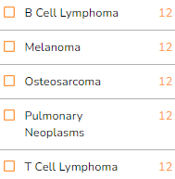
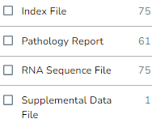
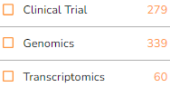
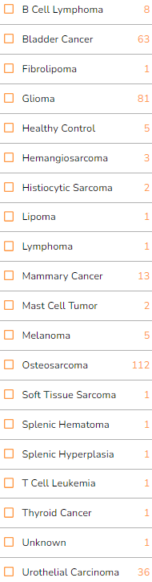

Program
Clinical Trial
Transcriptomics
File Type
.bai
.doc, .pdf, .rtf, .tif
.bam
Study type
Merged read counts
Genomics
download File Manifest from ICGC
upload this file in CGC
get file download link

Slide 7
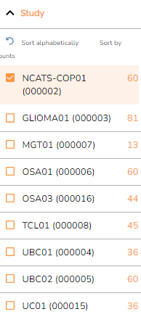
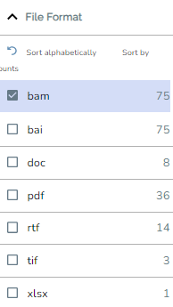
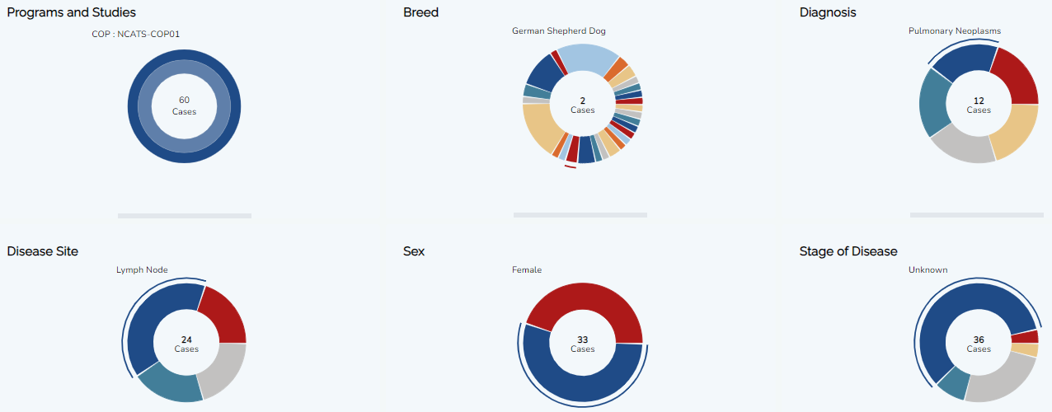

Slide 8
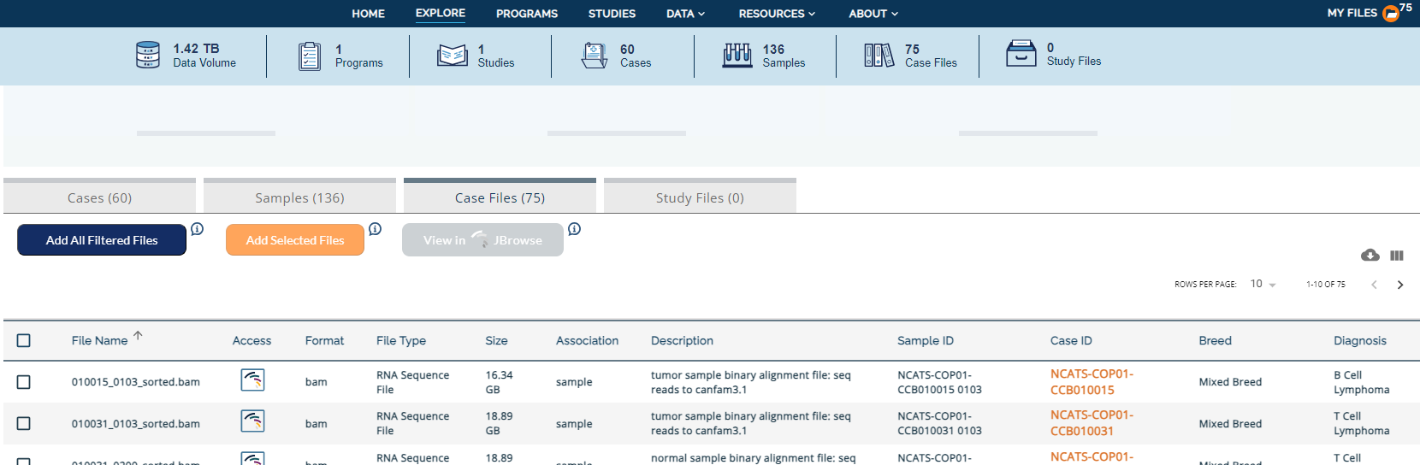
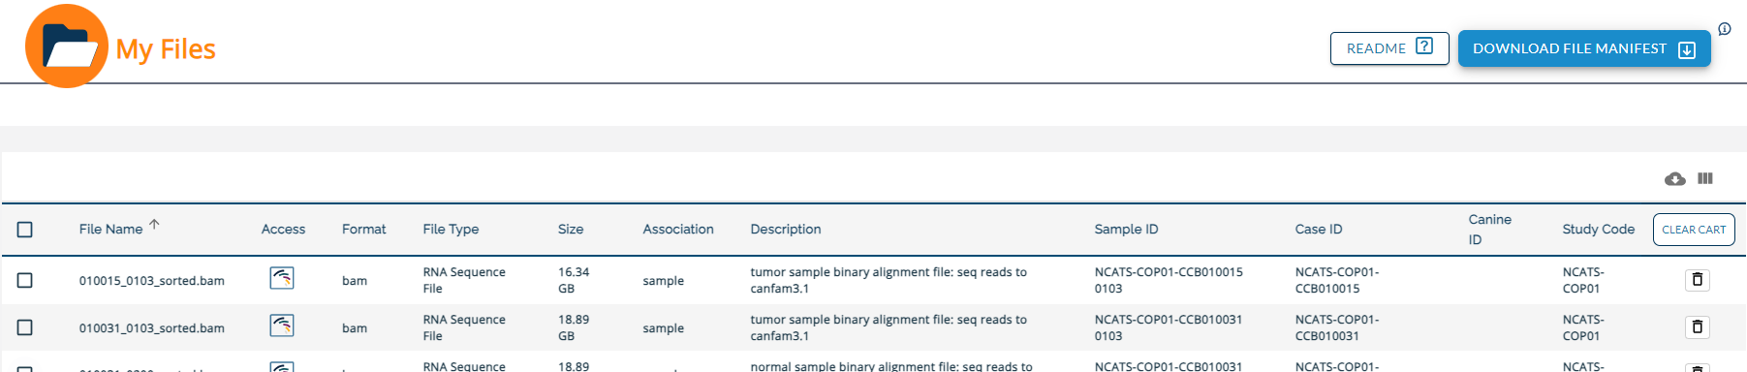
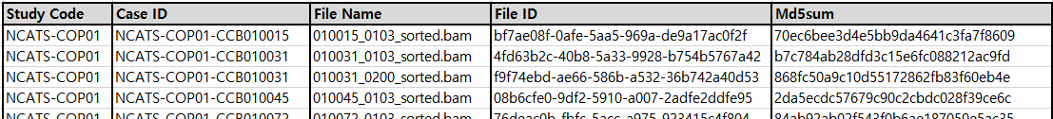
③
①
②
④
⑤ ICDC File Manifest.csv

Slide 9
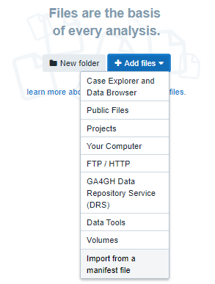
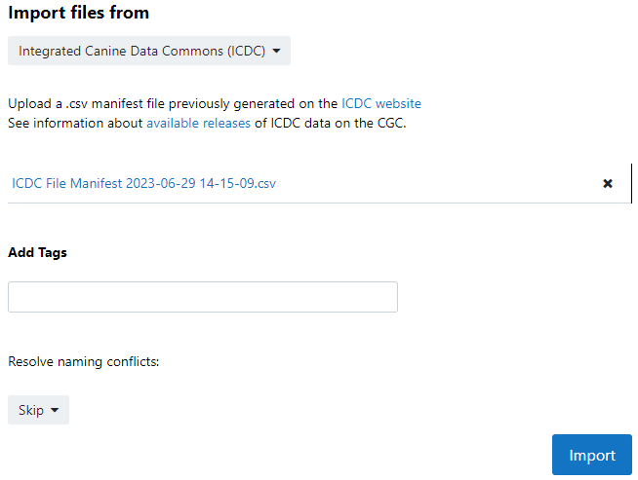
②
①
③

Slide 10
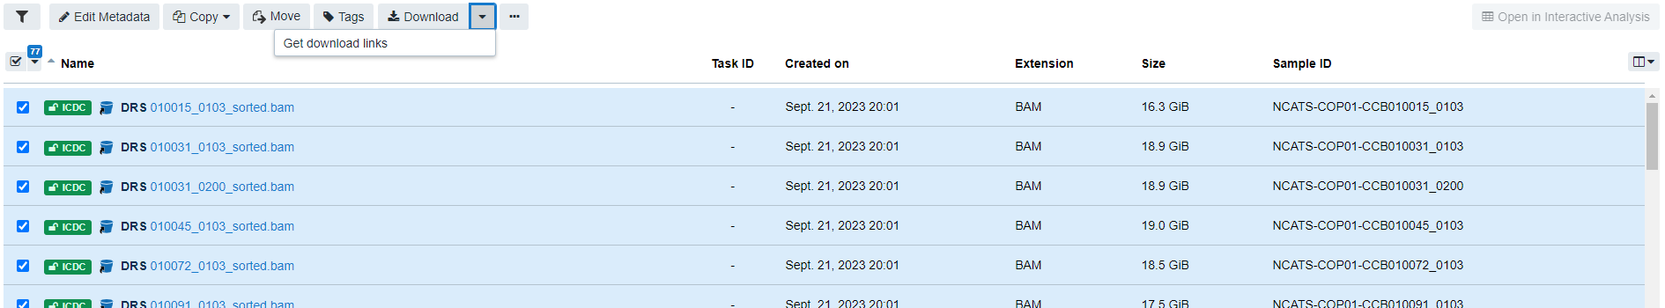
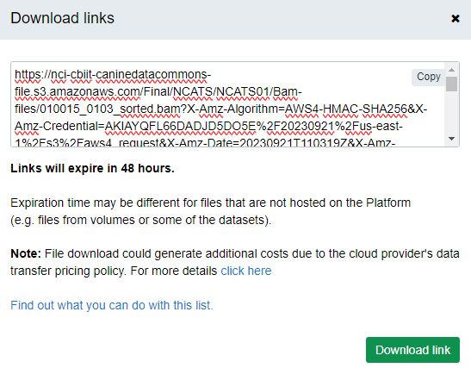
②
①

Slide 11
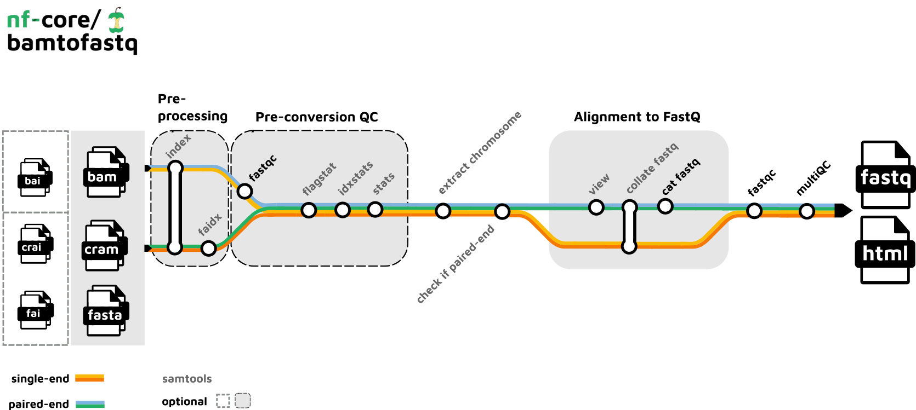
2023-09-19

Slide 12
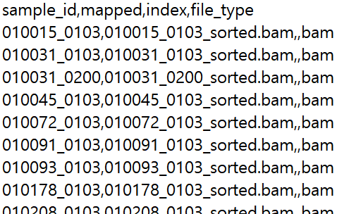

Slide 13
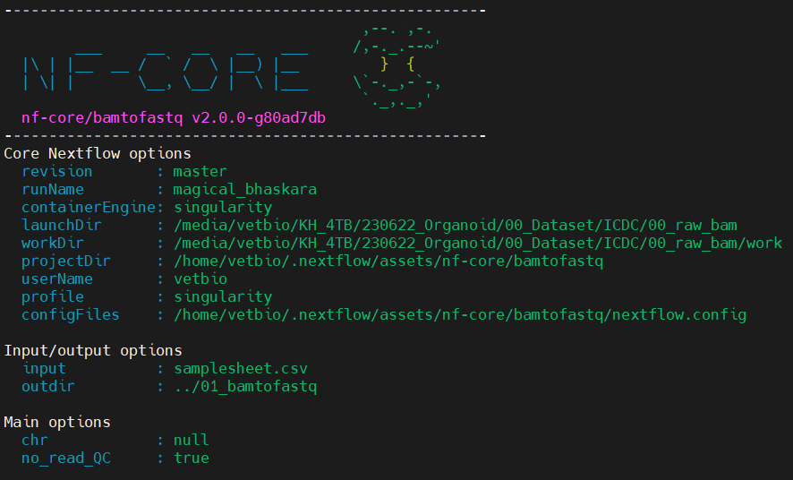

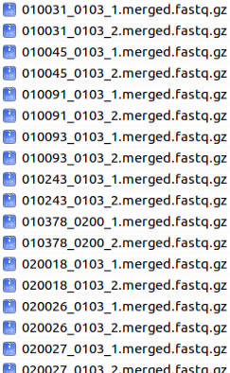
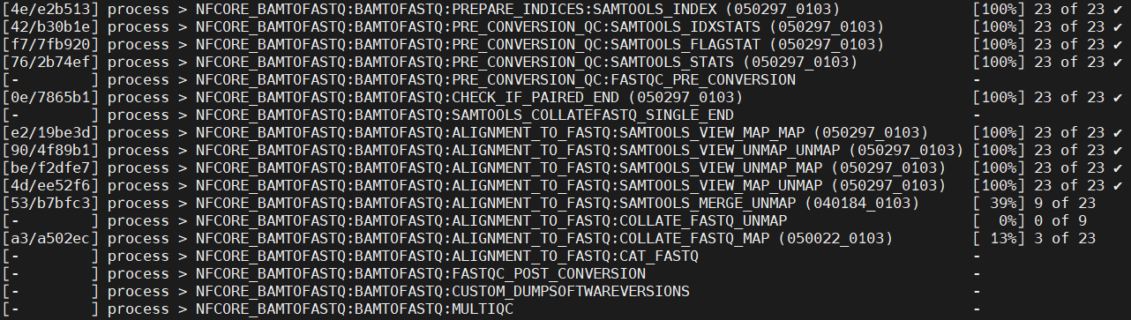
outdir/read/

Slide 14
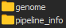
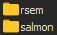
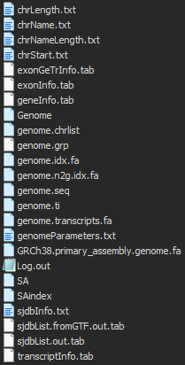
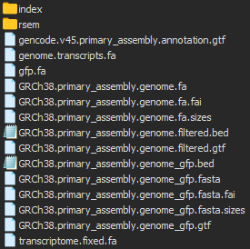
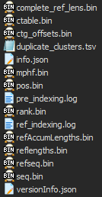
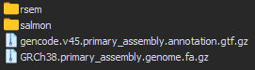
1.
2.

Slide 15
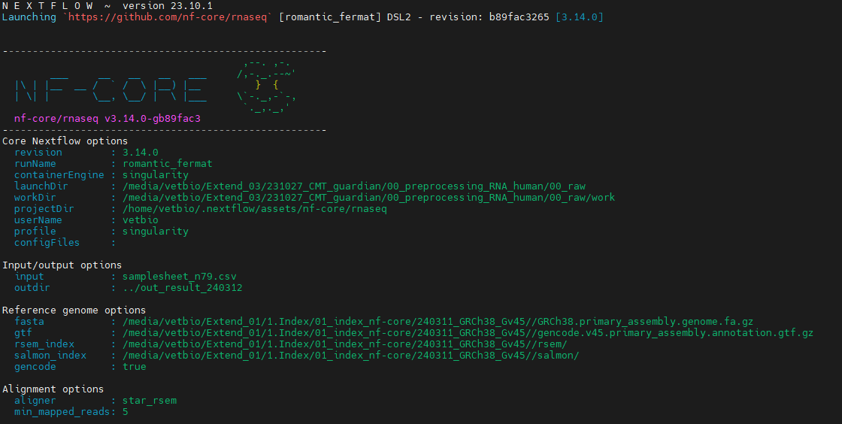
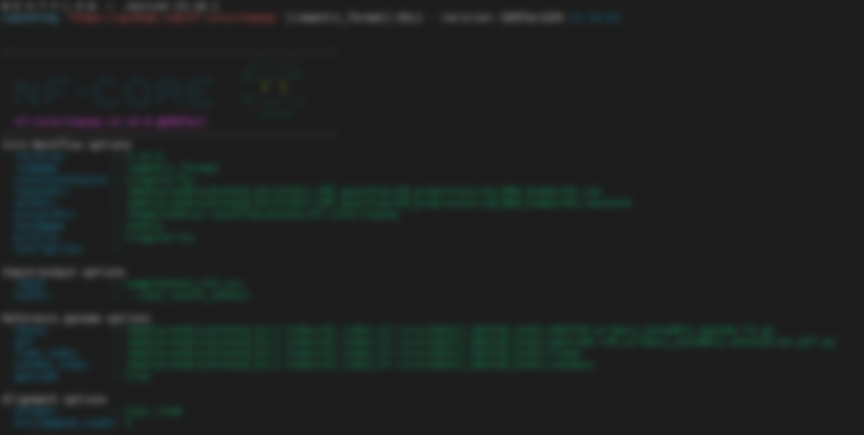
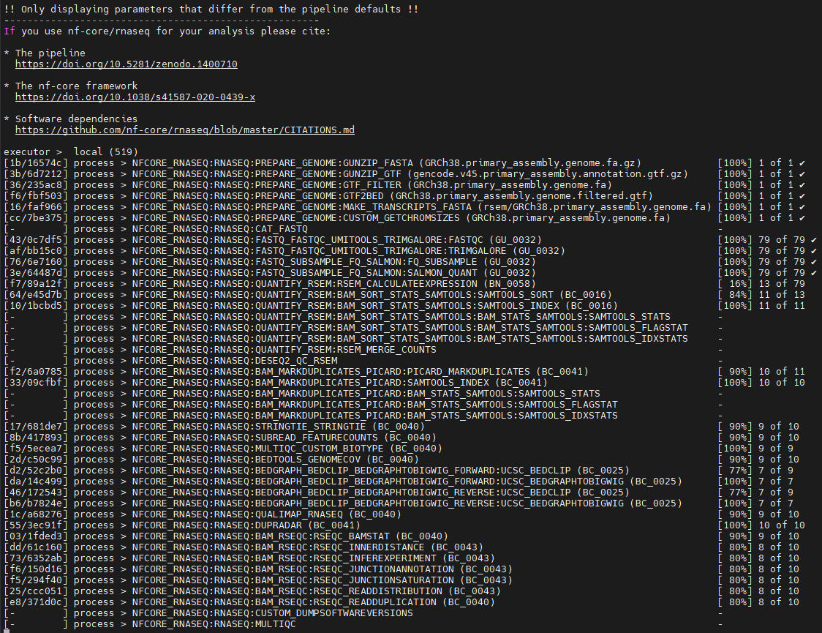

Slide 16
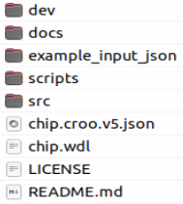
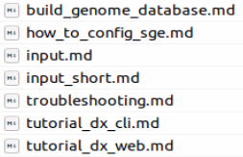
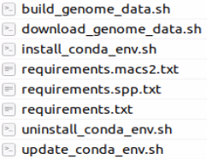

Slide 17
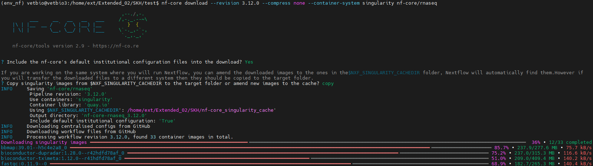

Slide 18
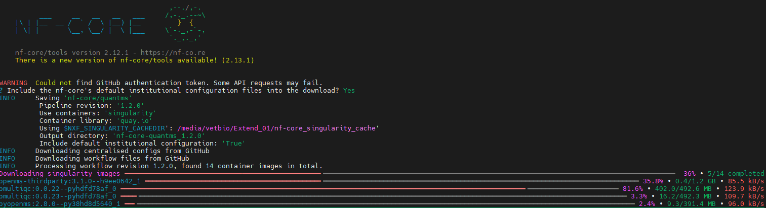
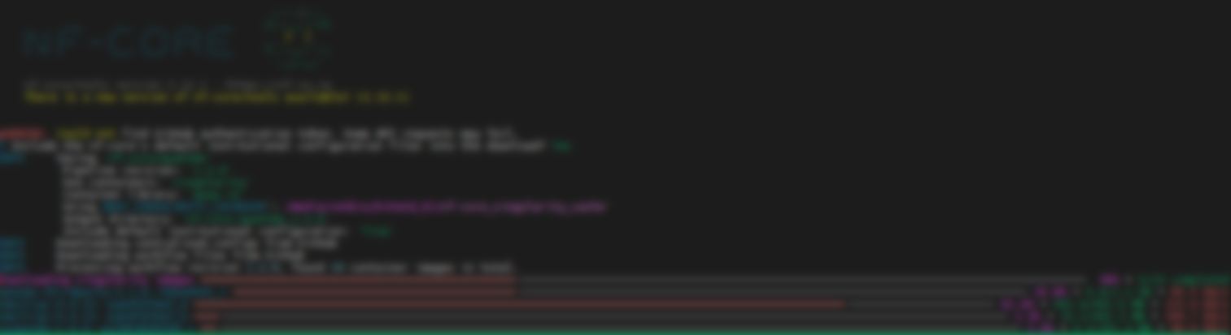

Slide 19
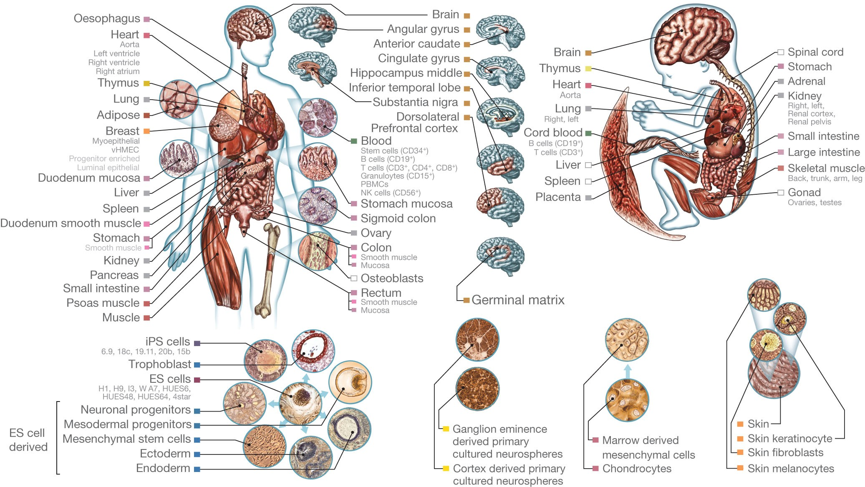
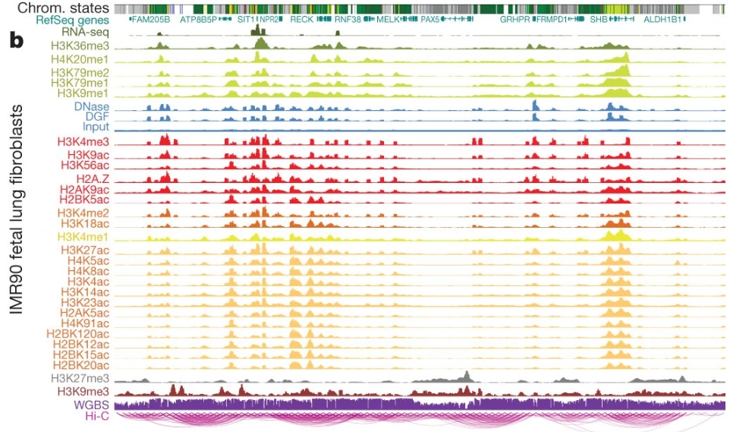

Slide 20
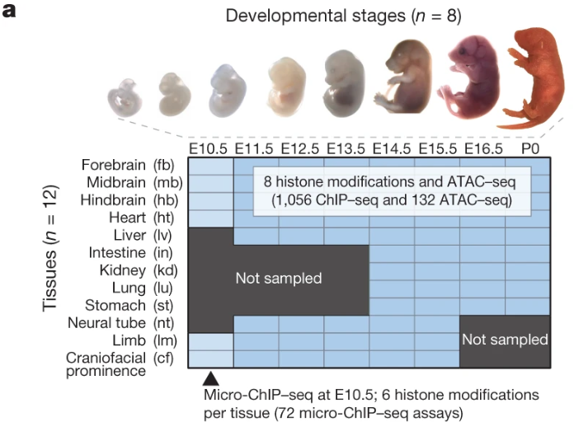
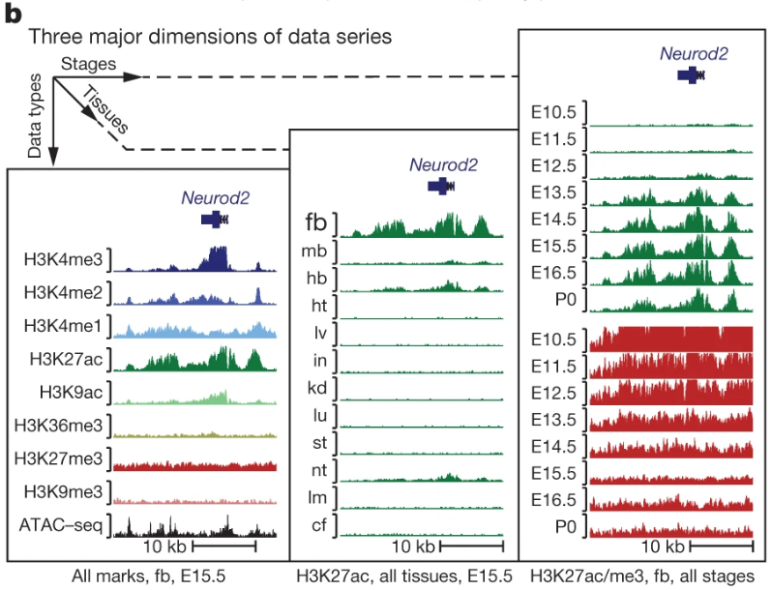

Slide 21
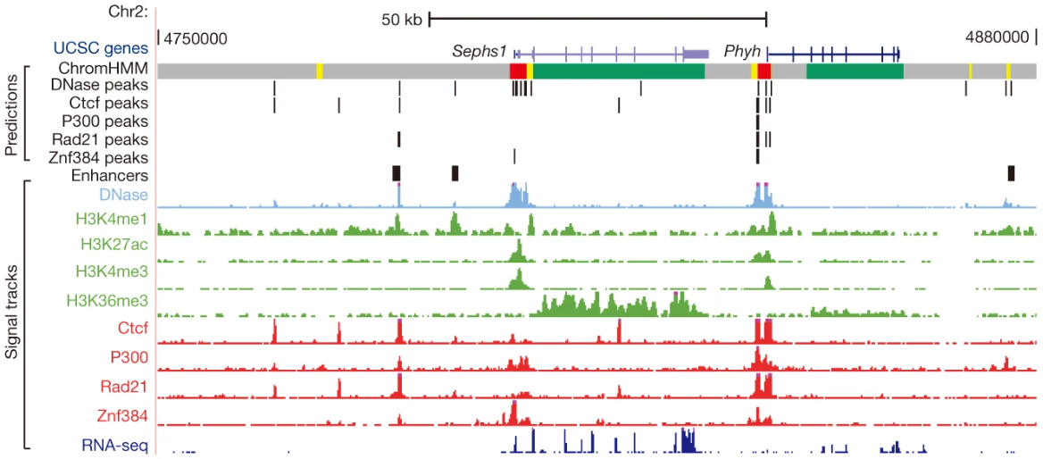
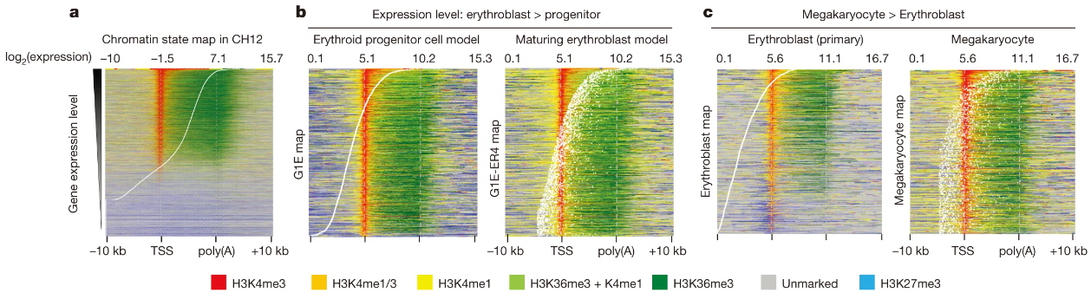

Slide 22
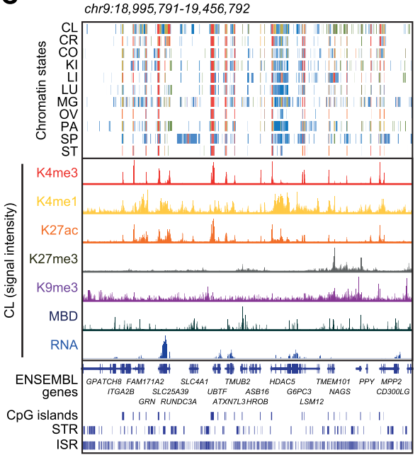


Slide 23



Slide 24




Slide 25


Slide 26




Slide 27



Slide 28



Slide 29


Slide 30


Slide 31

Umbrella project
PRJNA838579
BioProject
Sub-project
Transcriptome
(RNA-seq)
PRJNA838583
Sub-project
Epigenomics
(ChIP-seq)
PRJNA838586
Sub-project
Epigenomics
(MBD-seq)
PRJNA838585
BioSample
Sample
SAMN IDs
n = 22
Sample
SAMN IDs
n = 131
Sample
SAMN IDs
n = 33
Sample to sample
SRS <-> SAMN/EA/D
Study: SRP,ERP,DRP
Sample : SRS,ERS,DRS
Experiments: SRX,ERX,DRX
Runs: SRR,ERR,DRR
SRP375422
SRS/SRX/SRR IDs
n = 22
SRP375418
SRS/SRX/SRR IDs
n = 131
SRP375405
SRS/SRX/SRR IDs
n = 33
SRA
Sample to sample
GSM <-> SRS,ERS,DRS
SuperSeries
GSE203107
GEO
SubSeries (RNA)
GSE203106
Library
GSM IDs n = 22
SubSeries (ChIP)
GSE203104
Library
GSM IDs n = 131
SubSeries (MBD)
GSE203105
Library
GSM IDs n= 33
When I upload the generated data to a public database, I submit the
completed metadata spreadsheet to GEO depending on the data types.

Slide 32


Umbrella project
Sub-project

Slide 33


BioSample
SRA

Slide 34



SuperSeries (GSE203107)
SubSeries (GSE203104)
Sample (GSM6156731)

Slide 35
BioProject - Umbrella project
BioProject - Sub-project
BioSample

Slide 36


SRA - Study
SRA - Experiments

Slide 37
GEO - SuperSeries
GEO - SubSeries
GEO - Sample

Slide 38
INSDC (NCBI, EMBL-EBI, DDBJ)
NCBI’s GEO
SRA, ERA, DRA
BioProject &
BioSample
SuperSeries
GSE
Umbrella project
PRJNA/EB/D
SubSeries
GSE
Study
SRS, ERS, DRS
Sub-project
PRJNA/EB/D
Sample
SRS, ERS, DRS
Sample
SAMN/EA/D
Library
GSM
Experiments
SRX, ERX, DRX
Runs
SRR, ERR, DRR

Slide 39
BioProject - Umbrella project
BioProject - Sub-project
GEO - SuperSeries
GEO - SubSeries
GEO - Sample
BioSample
SRA - Study
SRA - Experiments

Slide 40
GEO
SRA
BioProject
①
②
BioSample
Raw data
Only raw data
Processed data

